Slide 1

D-MART SALES DASHBOARD
RAJKUMAR MASAL

Slide 2
1. INTRODUCTION 2. D-MART DASHBOARD 3. SELECTION OF YEAR,STATE AND CITY 4. SUM OF DISCOUNT PRICE AND SUM OF MRP BY CITY-WISE 5. SUM OF NO OF CLICKS BY Gender 6. MAX OF MRP BY PEYMENT METHOD 7. AVERAGE OF DISCOUNT PRICE AND AVERAGE OF MRP PRICE BY CITY
CLASSIFICATION
.

Slide 3

INTRODUCTION- D-mart is a popular retail chain in India that specializes in providing a one-stop-shop for a variety of consumer products. Founded in 2002 by Mr.Radhakishan Damani, D-mart has expanded its presence to over 200 stores in more than 70 cities across India.
.

Slide 4
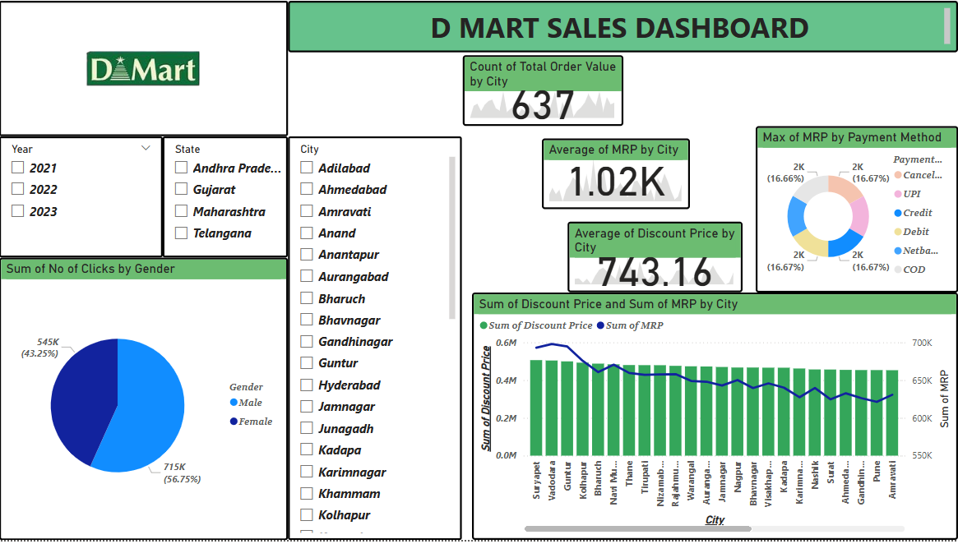

Slide 5
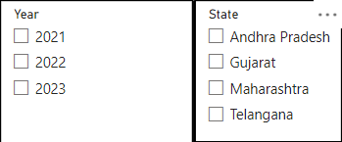
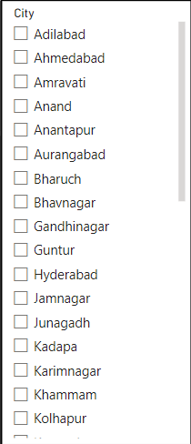
* To select the year , state and city and show the graphical representation of D-mart sale by using slicer
.

Slide 6
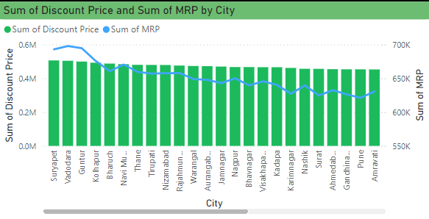
This is line and stacked bar chart shows the sum of Discount price and sum of MRP by city

Slide 7
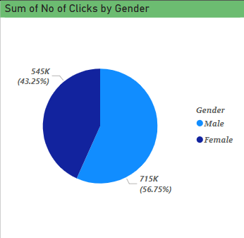
This pie-chart shows the sum of no of clicks by Gender
.

Slide 8
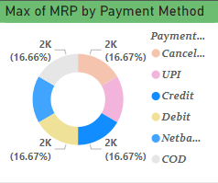
This chart shows the maximum of MRP by payment method by using Donut chart
.

Slide 9


This KPI indicator is shows the average of MRP by city
This KPI indicator is shows the average of discount price by city

Slide 10

Thank you
.

